Slide 1
Chapter 10
Behavior and Interaction
Resumes of the book
Computer Graphics using Java 2D and 3D
Computação Gráfica
Prof. Carlos Carreto
Engenharia Informática
Instituto Politécnico da Guarda

Slide 2
Objectives
Understand how to implement dynamic behaviors in Java 3D.
Understand the Java 3D API Behavior and WakeupCondition classes.
Apply Behavior nodes to scene graphs.
Use mouse behaviors.
Use key navigator behaviors.
Use view platform behaviors.
Combine picking and behaviors.

Slide 3
Behavior Class
There are two major types of dynamic behaviors:
  Animation
  Interactions
In Java 3D these dynamic behaviors are implemented with Behavior classes.

Slide 4
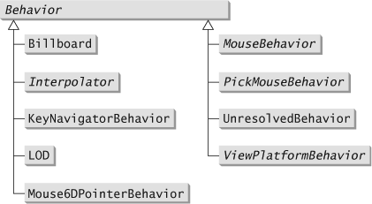
Behavior Class

Slide 5
Behavior Class
We can use predefined Behavior classes to create dynamic behaviors (animations or interactions).
It is also possible to create custom dynamic behaviors by implementing the interface class Behavior and their abstract methods.
  void initialize()
  void processStimulus(Enumeration wakeupCriteria)

Slide 6
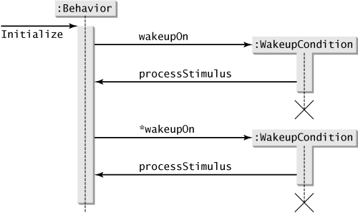
Execution Cycle of a Behavior
2. When this condition occurs, the Behavior is "awake" by calling its processStimulus method.
A WakeupCondition is configured during the initialization of a Behavior object.
3. After the code defined for the processStimulus method has been executed, a condition can be configured again to "wake up" the behavior, again calling the wakeupOn method.
4. The process repeats itself indefinitely.

Slide 7
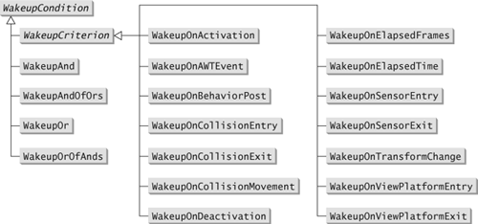
WakeupCondition Classes

Slide 8
WakeupCondition Classes
WakeupOnElapsedTime(long ms)
Creates a criterion to activate the behavior after a certain time has passed in milliseconds.
WakeupOnElapsedFrames(int frames)
Creates a criterion to activate the behavior after passing a certain number of frames.

Slide 9
WakeupCondition Classes
WakeupOnAWTEvent(int eventID)
Creates a criterion to activate the behavior when the specified AWT event occurs. For example, the following statement creates a criterion for the mouse-down event:
new WakeupOnAWTEvent(Event.MOUSE_DOWN);

Slide 10
WakeupCondition Classes
WakeupOnTransformChange(TransformGroup node)
Creates a criterion to activate the behavior when the transformation associated with the TransformGroup is changed.

Slide 11
WakeupCondition Classes
WakeupOnCollisionEntry(Bounds bounds)
WakeupOnCollisionEntry(Node node)
WakeupOnCollisionEntry(Node node, int speedHint)
WakeupOnCollisionEntry(SceneGraphPath path)
WakeupOnCollisionEntry(SceneGraphPath path, int speedHint)
Creates a criterion to activate the behavior when the specified object collides with another object in the scene graph.

Slide 12
WakeupCondition Classes
WakeupOnCollisionMovement(Bounds bounds)
WakeupOnCollisionMovement(Node node)
WakeupOnCollisionMovement(Node node, int speedHint)
WakupOnCollisionMovement(SceneGraphPath path)
WakupOnCollisionMovement(SceneGraphPath path, int speedHint)
Creates a criterion to activate the behavior when the specified object moves while colliding with another object in the scene graph.

Slide 13
WakeupCondition Classes
WakeupOnCollisionExit(Bounds bounds)
WakeupOnCollisionExit(Node node)
WakeupOnCollisionExit(Node node, int speedHint)
WakeupOnCollisionExit(SceneGraphPath path)
WakeupOnCollisionExit(SceneGraphPath path, int speedHint)
Creates a criterion to activate the behavior when the specified object stops colliding with another object in the scene graph.

Slide 14
WakeupCondition Classes
WakeupOnBehaviorPost(Behavior behavior, int postID)
Creates a criterion to enable behavior when the specified Behavior object generates the specified ID. A Behavior object can generate an event with a given ID using the postID method. This criterion monitors the behavior's postID. If the behavior parameter is null, the event may come from any Behavior object. If the parameter postID is 0, any ID satisfies the criteria.

Slide 15
Boolean Operators to Combine Activation Criterions
C1 = {W1}
C2 = {W2, W3}
ands = {W1, (W2 AND W3)}
condition = {W1 OR (W2 AND W3)}
WakeupAnd(WakeupCriterion[] criteria)
WakeupOr(WakeupCriterion[] criteria)
WakeupOrOfAnds(WakeupAnd[] criteriaAnds)
WakeupAndOfOrs(WakeupOr[] criteriaOrs)
WakeupCriterion[] criteria1 = {new WakeupOnElapsedTime(10000)};
WakeupCriterion[] criteria2 = {new WakeupOnElapsedFrames(5),
new WakeupOnCollisionEntry(node)};
WakeupAnd[] ands = {new WakeupAnd(criteria1),
new WakeupAnd(criteria2)};
WakeupOrOfAnds condition = new WakeupOrOfAnds(ands);
The example defines a wakeup condition where the wakeup occurs after 10 seconds or if 5 frames have passed and a collision has occurred.

Slide 16
Influencing Limits
The influence limit of a Behavior object can be configured through the methods:
SetSchedulingBounds(Bounds bounds)
SetSchedulingBoundingLeaf(BoundingLeaf bounds)

Slide 17
Implementation of Personalized Behaviors
Define a subclass of the Behavior class and rewrite the initialize and processStimulus methods.
Configure the appropriate wakeup condition in the initialize method. If necessary set up the wakeup condition again in the processStimulus method.
Create an instance of the custom Behavior class and add it to the scene graph as a leaf node.
Configure the influence limit of the Behavior object.

Slide 18
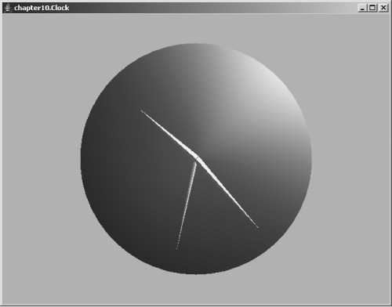
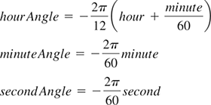
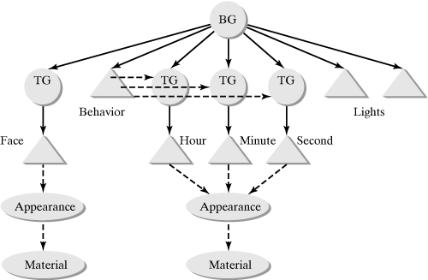
Example of Personalized Behavior
Code 10.1
Code 10.2
Run

Slide 19
Example of Personalized Behavior
// hour
. . .
Shape3D shapeHour = new Shape3D(createGeometry(0.4, 0.02, 0.02), ap);
TransformGroup spinHour = new TransformGroup();
spinHour.addChild(shapeHour);
. . .
// minute
Shape3D shapeMin = new Shape3D(createGeometry(0.5, 0.02, 0.02), ap);
TransformGroup spinMin = new TransformGroup();
spinMin.addChild(shapeMin);
. . .
// second
Shape3D shapeSec = new Shape3D(createGeometry(0.5, 0.01, 0.01), ap);
TransformGroup spinSec = new TransformGroup();
spinSec.addChild(shapeSec);
. . .
// Behavior node
ClockBehavior rotator = new ClockBehavior(spinHour, spinMin, spinSec);
BoundingSphere bounds = new BoundingSphere();
rotator.setSchedulingBounds(bounds);
root.addChild(rotator);

Slide 20
Example of Personalized Behavior
public class ClockBehavior extends Behavior {
TransformGroup tgH;
TransformGroup tgM;
TransformGroup tgS;
public ClockBehavior(TransformGroup transH, TransformGroup transM, TransformGroup transS) {
tgH = transH;
tgM = transM;
tgS = transS;
}
public void initialize() {
wakeupOn(new WakeupOnElapsedTime(500));
}
public void processStimulus(java.util.Enumeration enumeration) {
int hour = Calendar.getInstance().get(Calendar.HOUR);
int min = Calendar.getInstance().get(Calendar.MINUTE);
int sec = Calendar.getInstance().get(Calendar.SECOND);
Transform3D tr = new Transform3D();
tr.rotZ(-Math.PI * (hour+min/60.0)/6.0);
tgH.setTransform(tr);
tr.rotZ(-Math.PI * min /30.0);
tgM.setTransform(tr);
tr.rotZ(-Math.PI * sec /30.0);
tgS.setTransform(tr);
wakeupOn(new WakeupOnElapsedTime(500));
}
}

Slide 21
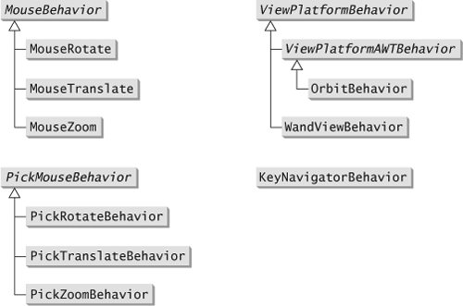
Interaction Behaviors

Slide 22
Behaviors to Implement Interaction with the Mouse
MouseRotate: drag the mouse with the left button pressed.
MouseTranslate: Drag the mouse with the right mouse button.
MouseZoom: drag the mouse with the middle button (or left-click while holding the Alt key down).
These classes operate on a given TransformGroup object and define specific behaviors related to mouse movement.

Slide 23
Behaviors to Implement Interaction with the Mouse
  Mouse behaviors can be linked with mouse events in two ways:
    Using WakeupOnAWTEvent to activate the behavior. The target is controlled by the mouse events in the Canvas3D object.
    Specifying the AWT component to listen for mouse events and using WakeupOnBehaviorPost to activate the behavior. This mode is useful when you want to apply mouse control from another AWT component.

Slide 24
Behaviors to Implement Interaction with the Mouse
Some constructors of the MouseBehavior classes:
MouseRotate(TransformGroup tg)
MouseRotate(Component c)
MouseRotate(Component c, TransformGroup tg)
MouseTranslate(TransformGroup tg)
MouseTranslate(Component c)
MouseTranslate(Component c, TransformGroup tg)
MouseZoom(TransformGroup tg)
MouseZoom(Component c)
MouseZoom(Component c, TransformGroup tg)
Constructors with a parameter of type Component allow us to indicate the AWT component that must listen for mouse events.

Slide 25
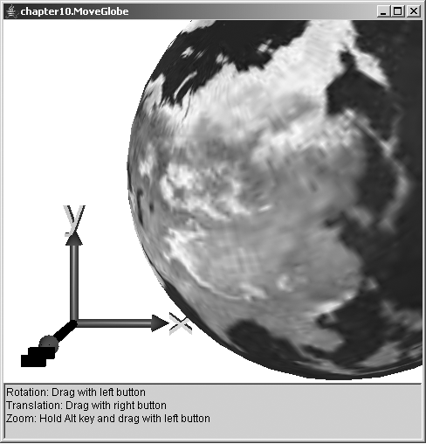
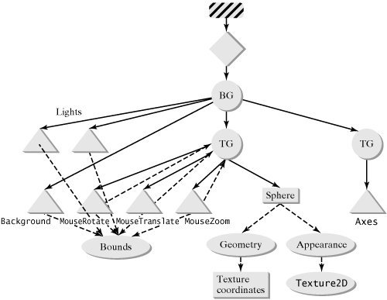
Behaviors to Implement Interaction with the Mouse
Code
Run

Slide 26
Behaviors to Implement Interaction with the Mouse
. . .
// texture mapped globe
Appearance ap = createAppearance();
spin.addChild(new Sphere(0.7f, Primitive.GENERATE_TEXTURE_COORDS, 50, ap));
// rotation
MouseRotate rotator = new MouseRotate(spin);
BoundingSphere bounds = new BoundingSphere(); rotator.setSchedulingBounds(bounds);
spin.addChild(rotator);
// translation
MouseTranslate translator = new MouseTranslate(spin); translator.setSchedulingBounds(bounds);
spin.addChild(translator);
// zoom
MouseZoom zoom = new MouseZoom(spin);
zoom.setSchedulingBounds(bounds);
spin.addChild(zoom);
. . .

Slide 27
Behaviors to Implement Interaction with the Mouse
Like the MouseBehavior classes, the KeyNavigatorBehavior class acts on a TransformGroup object, but now the behavior is controlled by pressing specific keys.
The KeyNavigatorBehavior class has the following constructors:
KeyNavigatorBehavior(TransformGroup tg)
KeyNavigatorBehavior(Component c, TransformGroup tg)

Slide 28
Behaviors to Implement Interaction with the Mouse
The KeyNavigatorBehavior class implements the following features:
<left>, <right>: Rotate left/right
<up>, <down>: Translate forward/backward
Alt-<left>, Alt-<right>: Translate left/right
PgUp, PgDn: Rotate up/down
Alt-PgUp, Alt-PgDn: Translate up/down
-: Reduce back clip distance
+: Reset back clip distance
=: Reset

Slide 29
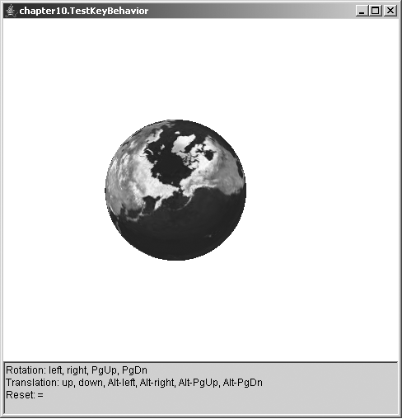
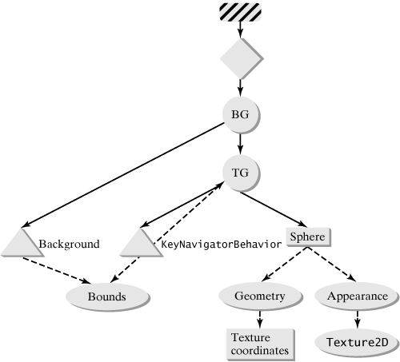
Behaviors to Implement Interaction with the Mouse
Code
Run

Slide 30
Behaviors to Implement Interaction with the Keyboard
. . .
TransformGroup spin = new TransformGroup(); spin.setCapability(TransformGroup.ALLOW_TRANSFORM_WRITE); spin.setCapability(TransformGroup.ALLOW_TRANSFORM_READ); root.addChild(spin);
// texture mapped globe
Appearance ap = createAppearance();
spin.addChild(new Sphere(0.7f, Primitive.GENERATE_TEXTURE_COORDS, 50, ap));
// key behavior
KeyNavigatorBehavior behavior = new KeyNavigatorBehavior(spin);
BoundingSphere bounds = new BoundingSphere();
behavior.setSchedulingBounds(bounds);
spin.addChild(behavior);
. . .

Slide 31
Behavior to Manipulate the View
The OrbitBehavior class allows you to change the TransformGroup associated with the Viewplatform by interacting with the mouse. The class has the following constructors:
  OrbitBehavior()
  OrbitBehavior(Canvas3D cv)
  OrbitBehavior(Canvas3D cv, int flags)
An OrbitBehavior object is added to the scene graph via the setViewPlatformBehavior method of the ViewingPlatform class:
  OrbitBehavior orbit = new OrbitBehavior(cv);
  orbit.setSchedulingBounds(new BoundingSphere());
  su.getViewingPlatform().setViewPlatformBehavior(orbit);

Slide 32
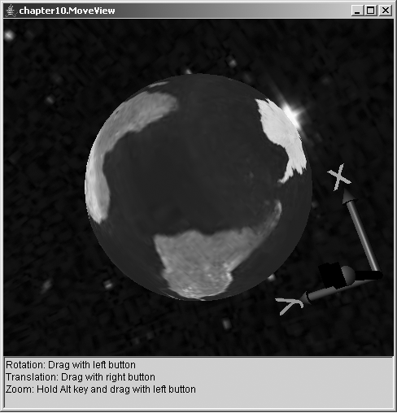
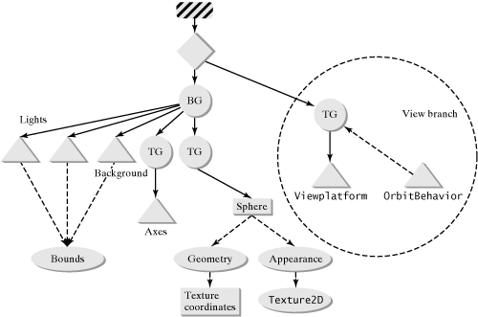
Behavior to Manipulate the View
Code
Run

Slide 33
Behavior to Manipulate the View
. . .
SimpleUniverse su = new SimpleUniverse(cv); su.getViewingPlatform().setNominalViewingTransform();
// viewplatform motion
OrbitBehavior orbit = new OrbitBehavior(cv); orbit.setSchedulingBounds(new BoundingSphere()); su.getViewingPlatform().setViewPlatformBehavior(orbit);
. . .

Slide 34
Behaviors to Implement Interaction with the Mouse and Picking
The PickMouseBehavior classe (PickRotateBehavior, PickTranslateBehavior, and PickZoomBehavior), combine interaction with the mouse and object picking.
The mouse-controlled rotation, translation, and zoom transformations are the same as those defined in the MouseBehavior class, but are only applied to the selected object with picking.
The creation of a PickMouseBehavior node involves the Canvas3D object, the root of a branch of the scene graph where it is intended to pick and influence limits:
PickRotateBehavior rotator =
new PickRotateBehavior(cv, root, bounds);
root.addChild(rotator);

Slide 35
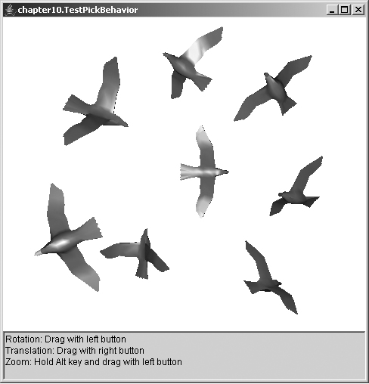
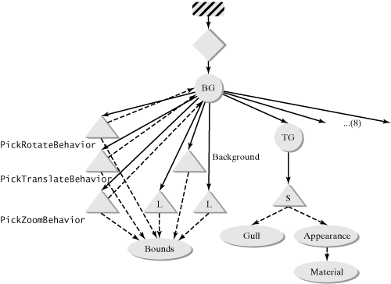
Behaviors to Implement Interaction with the Mouse and Picking
Code
Run

Slide 36
Behaviors to Implement Interaction with the Mouse and Picking
. . .
BoundingSphere bounds = new BoundingSphere();
// rotation
PickRotateBehavior rotator = new PickRotateBehavior(root, cv, bounds, PickTool.GEOMETRY);
root.addChild(rotator);
// translation
PickTranslateBehavior translator = new PickTranslateBehavior(root, cv, bounds, PickTool.GEOMETRY);
root.addChild(translator);
// zoom
PickZoomBehavior zoom = new PickZoomBehavior(root, cv, bounds, PickTool.GEOMETRY);
root.addChild(zoom);
. . .

Slide 37
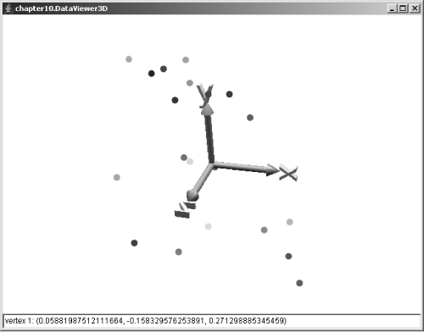
Data Visualization
The combination of picking and behaviors provides a powerful tool for interaction with a 3D scene. Picking allows you to select objects, and the behaviors provide a way to change the view of the scene.
In a data visualization application, for example, interaction behaviors will be a useful resource for the user to be able to rotate, move and zoom a set of data, in order to improve their perception. Picking will also be a useful resource for the user to select specific data.
Code
Run

Slide 38
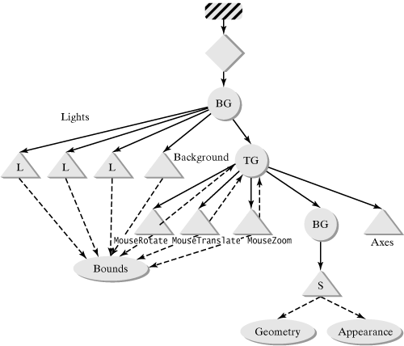
Data Visualization

